Slide 1


EMBEDDED SYSTEMS DESIGN
By: ROHIT UPADHYAY
(05115002817)

Slide 2

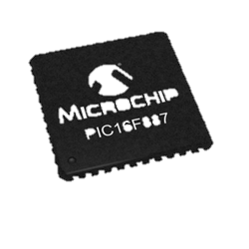
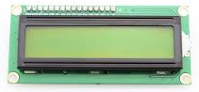
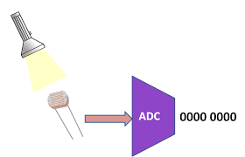
CONTENTS
Embedded Systems
Microprocessors and Microcontrollers
PIC Microcontroller
Displays in Embedded Systems
ADC Module
Timer Module
Interrupt
UART
PCB Designing

Slide 3


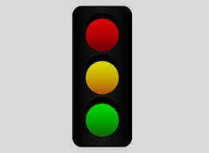
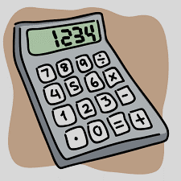
EMBEDDED SYSTEMS
An embedded system is a microcontroller or microprocessor based system which is designed to perform a specific task. Some real life applications of embedded systems include:
Digital Cameras
Cars
Calculator
Air-conditioners
Traffic Lights

Slide 4

MICROCONTROLLER VS
MICROPROCESSOR
A microcontroller includes a processor , memory and I/O peripherals on a single chip.
Performs a specific task.
Microcontrollers are less expensive
than microprocessors.
Power consumption in microprocessors is low.
Microprocessors do not have built in RAM, read-only memory (ROM) or other peripherals on the chip.
Build to do multiple tasks .
The accompanying peripherals make a microprocessor quite expensive.
Power consumption is higher than that in microcontrollers.

Slide 5
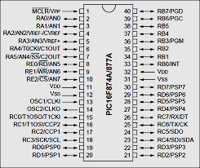
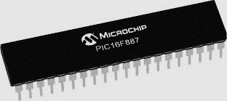
PIC 16F887
PIC 16F877 is one of the most advanced microcontroller from Microchip. Some features of PIC 16F887 are:
Only 35 simple word instructions.
Wide operating voltage range (2.0 – 5.56)volts.
10bit multi-channel A/D converter.

Slide 6
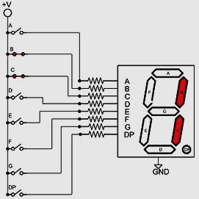
DISPLAYS
SEVEN SEGMENT DISPLAY:
There are two types of Seven Segment Displays:
Common Cathode
Common Anode
This is a Common Cathode type seven segment display. As you can see in the adjoining figure, the LEDs are connected to a common ground (i.e common cathode).

Slide 7
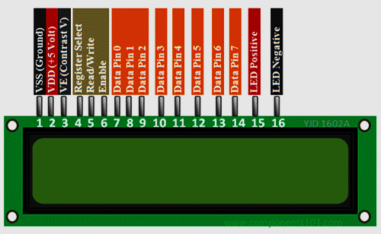
b) LIQUID CRYSTAL DISPLAY:
LCD screen is an electronic display module and find a wide range of applications.
A 16x2 LCD display is very basic module and is very commonly used in various devices and circuits.
16×2 LCD is named so because; it has 16 Columns and 2 Rows.

Slide 8
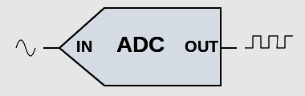
ANALOG TO DIGITAL CONVERTER
Analog to Digital Converter (ADC) is a device that converts an analog quantity (continuous voltage) to discrete digital values.
The operation of A/D converter is in control of the bits of four registers:
ADRESH
ADRESL
ADCON0
ADCON1

Slide 9

TIMER
TIMER 0
8 bit
8-bit Prescaler
TIMER 1
16 bit
3-bit Prescaler
TIMER 2
8 bit
8 bit Prescaler
There are 3 inbuilt timers in PIC 16F887 namely Timer 0, Timer1 and Timer 2.
Formula for calculating the counts of a Timer0.

Slide 10
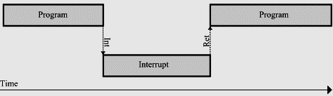
interrupt
An interrupt is a signal sent to the processor that interrupts the current process.
These registers control the interrupt:
INTCON
PIE
GIE

Slide 11
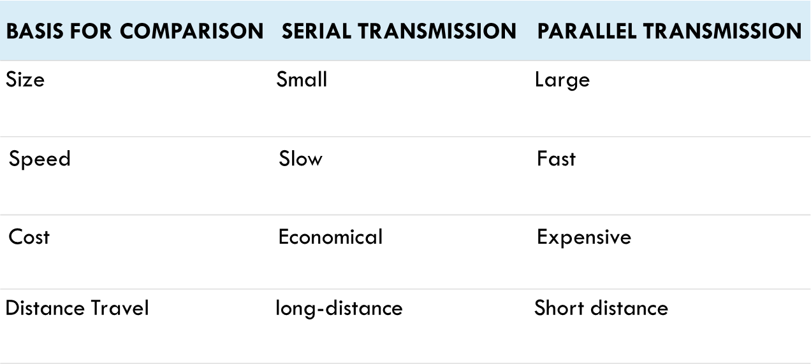
UART
UART stands for Universal Asynchronous Receiver Transmitter.
It is a serial communication interface which uses two lines for sending and receiving (data.

Slide 12
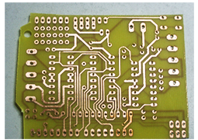
PCB DESIGNING
PCB stands for Printed Circuit Board.
WHAT IS PCB DESIGNING?
PCB design brings your electronic circuits to life in the physical form.
To make a printed circuit board you need to:
Design schematics.
Draw the circuit board layout.
Get the board made.

Slide 13
THANK YOU

